Slide 1
Census 2020
El Censo
Created by Houston in Action

Slide 2
Registration
Please don’t forget to check-in.
Find a seat.

Slide 3
Welcome
Please familiarize yourself with the building: bathrooms, exits, etc.
Open mind, spirit of receptiveness
Issues? Evaluations. Needs?
Questions?
Notes:
Chris’s slide

Slide 4
Agenda
Welcome
Our Story
Community Exercise Quiz? Check in? Intro?
What is the Census
Why Census Matters Our ask, your commitment
How to Get involved and next steps

Slide 5
Community Agreements
These agreements we’ll have together about how we agree to show up and treat one another during our time together.
Think about why we’re here, the values we all share, and what you need to learn, be present, and remain grounded throughout these five days.
Notes:
Community Agreements should go up on a butcher sheet for that can stay up for the full length of the training.

Slide 6
My Story and Why does the Census Matter to me and my community.
Culture and Values.
Notes:
This section only took about 35 mins.

Slide 7
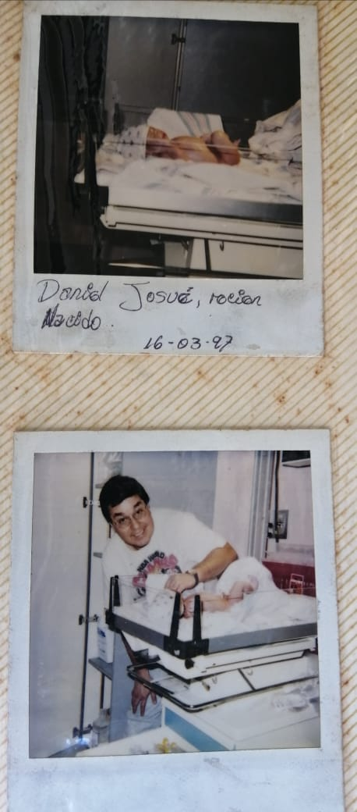
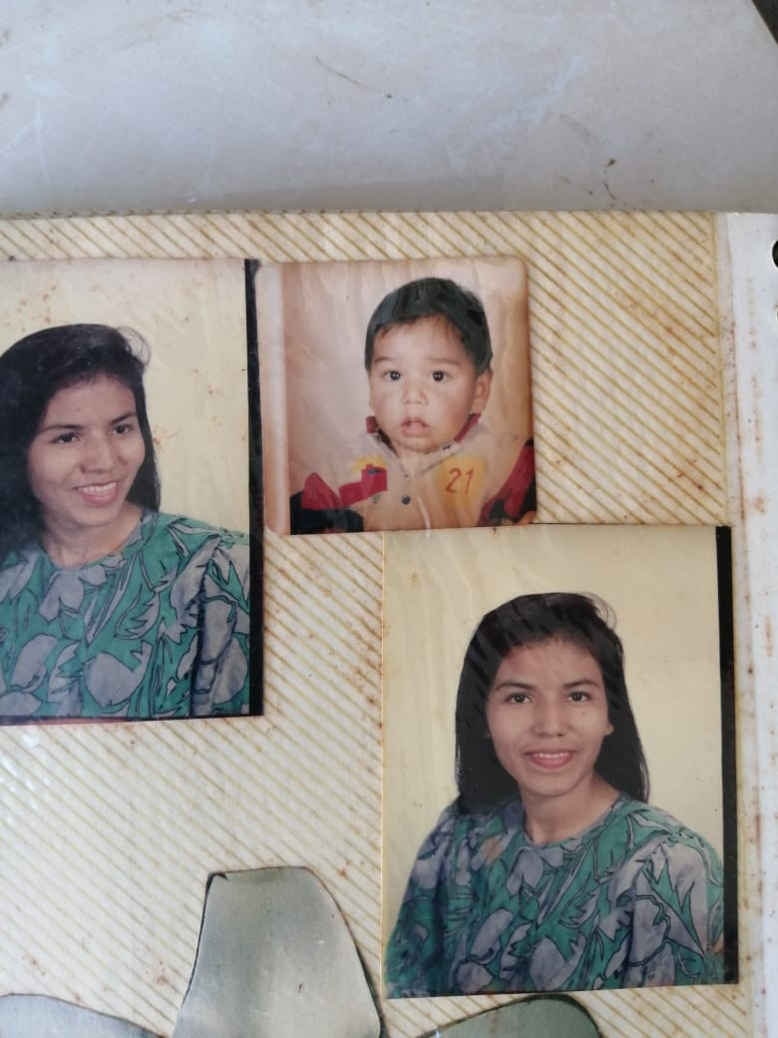
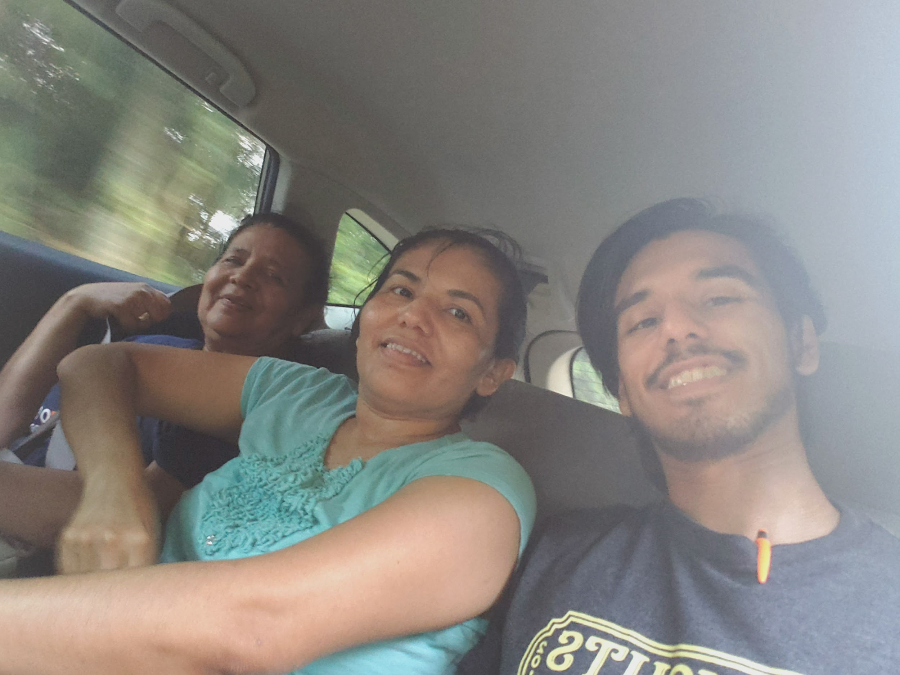
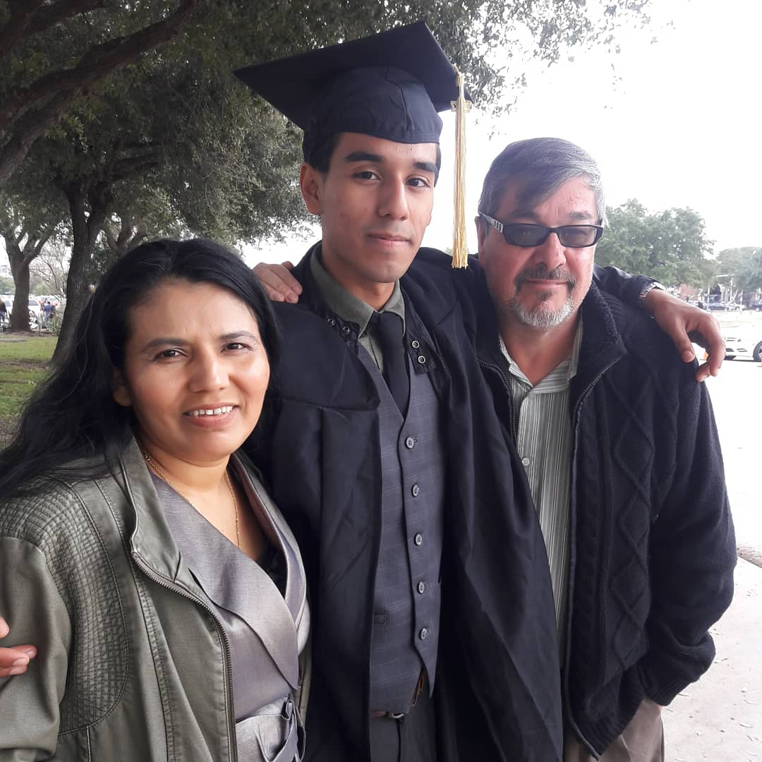

Slide 8
Quiz? Check in? Intro?
Community Exercise
Notes:
This section only took about 35 mins.

Slide 9
[Quiz] [Check in Question? ] [Intro]
[HiA Census Quiz​: bit.ly/censusquiz]
[Q?: What do you love about your community?]
[Intro: Name and where you grew up]
Notes:
Community Agreements should go up on a butcher sheet for that can stay up for the full length of the training.

Slide 10
What is the Census
Who is counting us and why
Notes:
This section only took about 35 mins.

Slide 11
We, BakerRipley, are not the Census Bureau
Our role is to inform, empower, and build community.
Notes:
We are not here to represent the Census Bureau

Slide 12
Source of video: US Census Bureau

Slide 13
What is the Census?
Source of video: US Census Bureau
Notes:
Community Agreements should go up on a butcher sheet for that can stay up for the full length of the training.

Slide 14
Recap: 2020census.gov
The U.S. Constitution empowers the Congress to carry out the census in "such manner as they shall by Law direct" (Article I, Section 2)... The plan was to count every person living in the newly created United States of America, and to use that count to determine representation in the Congress.
The census provides critical data that lawmakers, business owners, teachers, and many others use to provide daily services, products, and support for you and your community. Every year, billions of dollars in federal funding go to hospitals, fire departments, schools, roads, and other resources based on census data.
Notes:
Community Agreements should go up on a butcher sheet for that can stay up for the full length of the training.

Slide 15
Why Census Matters
Our Ask and Your Commitment
Notes:
This section only took about 35 mins.

Slide 16
What is the Census?
Decennial count
Cuenta a todos (ciudadano, residente, etc.) (adultos, niños de cualquier edad)
Mandated by the constitution
Affects many aspects of the country

Slide 17
Census Data/Datos del Censo
Determina cuántos representantes estatales se asignan y ayuda a guiar las líneas de los distritos
Supervisa la efectividad de los proyectos de derechos civiles.
Necesidades de planificación comunitaria: calles/carreteras, escuelas, negocios, hospitales, daycares, etc.
$800 billion will be distributed to state and local federal assistance programs (SNAP, Headstart, CHIP, Medicare, Section 8, etc) based on geographic data.
Notes:
Él reparto gobermental depende del censo (determina él numero de representates en él congreso)
Determina la redistribucion de distritos en todos los niveles del gobierno.

Slide 18
State | Amount (in billions)
California | $115.1
New York | $73.3
Texas | $59.4
Florida | $44.2
Illinois | $34.3
North Carolina | $23.8
Georgia | $23.8
New Jersey | $22.7
Arizona | $20.6
Census-Guided Federal Funds Annually
Allocated to Selected States
Notes:
We are not here to represent the Census Bureau

Slide 19
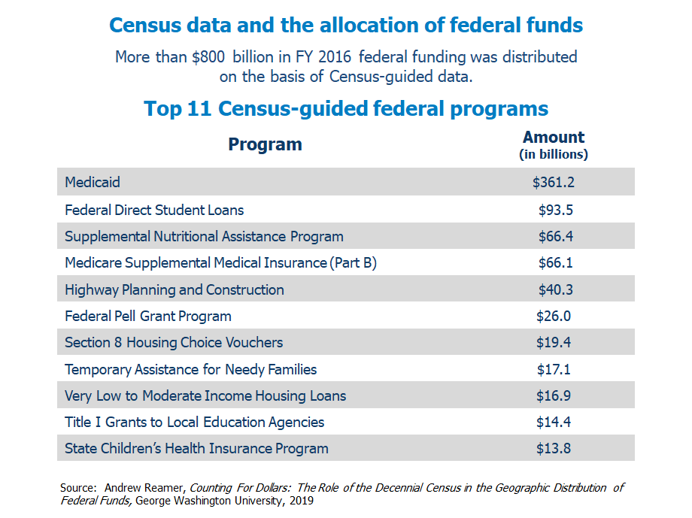
Source: NALEO Educational Fund
Notes:
Add up the #s

Slide 20
Risk of Being Undercounted
Rural residents
Very young children aged 0-5
Households with low incomes
Black, Latinos and Asian American Pacific Islander
Immigrants and low English-language proficiency
Renters Residents who live in non-traditional housing
Highly mobile residents, such as farmworkers
Youth 18-24

Slide 21
Very young children are most likely to be excluded from the Census count
Census 2010 missed 2.2 million very young children, and double counted 1.2 million, for a net undercount of 1 million children.
The 2010 net undercount rate for very young Latino children was 7.1%, and 6.3% for African American children
Source: Child Trends Hispanic Institute and NALEO Educational Fund, The Invisible Ones: How Latino Children are Left out of our Nation’s Census Count.

Slide 22
Current state of the citizenship question
As a result of the June 27 U.S. Supreme Court ruling, the Administration will not add a question on U.S. citizenship to Census 2020.
Judges in all three lower court cases (New York, Maryland, California) issued orders to permanently block:
Addition of the citizenship question or any effort to ask about citizenship on 2020 Census
Any delay in the printing of Census questionnaires after June 30.

Slide 23
Census Confidentiality (Confidencialidad)
Under Title 13 of U.S. Code:​
​Census data can only be used for statistical purposes; personal information cannot be used against respondents in court or by a government agency.​
​Personal census information cannot be disclosed for 72 years (includes names, addresses, and telephone numbers).​
​Census Bureau staff who have access to personal information are sworn for life to protect confidentiality.​
Sworn staff are subject to a $250,000 fine and/or up to five years in prison for wrongful disclosure of information.​
Source: NALEO Educational Fund

Slide 24
Census Protection
The form does not cost anything
Enumerators are people hired by the US Census to follow up with you in case you did not fill out the from between March 13-end of May.
Census Bureau online or in person enumerators should NOT ask for any confidential information such as: Social Security Number, immigration status or requesting access to financial information.
Census Bureau online or in person enumerators will NOT ask for money or donations.
.

Slide 25
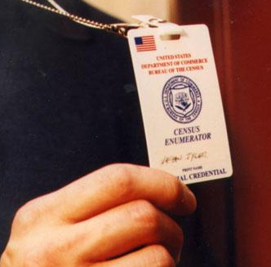
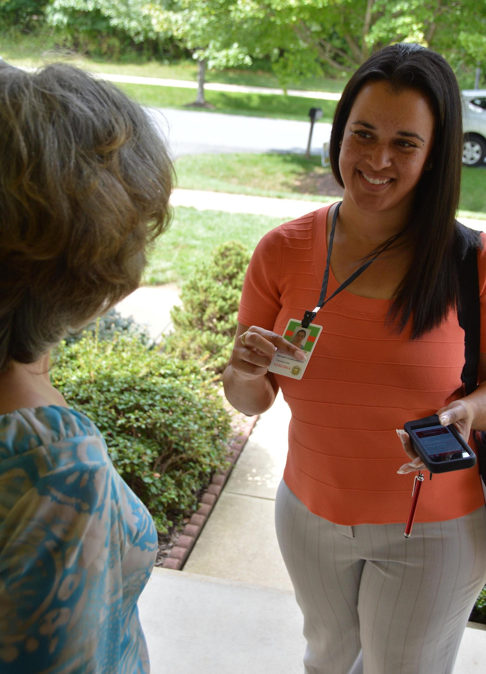
Census Protection
People will identify themselves as enumerator with the US Census Bureau with an ID.
If someone comes to your door pretending to be an enumerator, you can:
Call NALEO’s Census Hotline at 877-el censo or 877-352-3676.
Call the Census Bureau @ 800-923-8282
Reach out to us! Dmeza@bakerripley.org

Slide 26
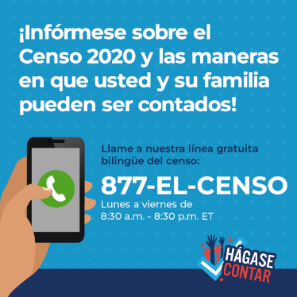
877-EL-CENSO (877-352-3676)
Bilingual Census Information Hotline
Monday – Friday: 8:30 a.m. – 8:30 p.m. ET
Fully trained bilingual staff and trusted messengers ready to answer all census related questions, including:
Information about Summer 2019 test
Census outreach events in your community
How and where to apply for Census jobs
Up to date information on Census operations and CQ
Flagging major issues and rapid response referrals
Self response methods and non response follow up
Basic information on questionnaire and who should be included
Notes:
Talk about the resources.
NALEO Hotline
FAQs on Dos and Donts
Reach out to us

Slide 27
Census Dates
Source: Arizona Education News Service

Slide 28
Key Census 2020 Dates
January 2020:
Counting begins in remote areas of Alaska
March – April 2020:
Households self respond to Census 2020 online, by phone, or by mail (four waves of staggered mail)
April 1, 2020: National Census Day
May – July 2020:
Follow-up phase for households that did not self-respond
December 31, 2020:
Census Bureau delivers final apportionment count to White House
Source: NALEO Educational Fund

Slide 29
All it Takes is One person
The Census only needs one person from your household to get everyone Counted.
Census will ask about how many people live in the Household, Ethnicity, Age, Gender, Homeowner or Renter, and other information.

Slide 30
Will you Commit to filling out the Census?
April 1, 2020

Slide 31
How to Get involved
And Next steps
Notes:
This section only took about 35 mins.

Slide 32
BakerRipley
Senior Outreach
Visit Seniors
Date
Ripley House/Harbach
Contact
Volunteer Appreciation
Description
Date
Location
Contact
Food Fair
Community Outreach
Date
Ripley House/Leonel Castillo/
Contact
Senior Turkey Giveaway
Description
Date
Location
Contact
Notes:
Also Holiday Connection

Slide 33
Thank you. Gracias. Merci.
[Daniel “Danny” Meza]
[Community Engagement Manager/Census Organizer] [dmeza@bakerripley.org]
www.bakerripley.org

Slide 34
Why are we here today?
Let’s start by grounding ourselves.
You’ll have 5 minutes to work on the worksheet in your folder.
Starting our conversation about organizing.

Slide 35
Civic Health Index
● Greater Houston residents are about 12 percentage points less likely to trust all or most of their neighbors than the average American. Greater Houston ranks towards the bottom on this indicator compared to other large metro areas (42nd out of 50).
● Greater Houston residents are about 4 percentage points less likely to volunteer than the average American. Greater Houston ranks towards the bottom on this indicator compared to other large metro areas (46th out of 50).
● Residents of the region struggle to discuss politics with their families as well as communicate with elected officials.
● Greater Houston has had difficulty incorporating naturalized citizens into political life. Naturalized citizens are about 7 percentage points less likely to be registered to vote than native-born citizens, and 12 percentage points less likely to frequently discuss politics with friends and family.
● Despite the large shares of Hispanic residents throughout the region, people with Hispanic surnames are underrepresented in the Harris County electorate, candidate pool, and as a share of local elected officials.
● Women are underrepresented in the Harris County candidate pool, and as a share of local elected officials.

Slide 36
We believe...
Our community is not defined by political moments or cycles. We define ourselves by our willingness to rely on each other, ourselves and the systems meant to support us for generations to come.

Slide 37
What moves people?
Stories are a cycle.
THE HERO’S JOURNEY
● Systemic Oppression
● Unjust laws
● Fear
● Historical Racism
● Worthlessness
CHANGE IS POSSIBLE

Slide 38
CHANGE IS POSSIBLE
● Systemic Oppression
● Unjust laws
● Fear
● Historical Racism
● Worthlessness
HOPE
^{YOUR STORIES}
_{TAKE ACTION}
MORAL: Is your story hopeful?
Community

Slide 39
Story of Self
Shift (Cambio) - The challenge you faced (reto/obstaculo)
Push - Él momento que te hizo actuar/cambiar
Impact - How that moment or action changed you and que aprendiste
Ask - What do you want people to do? How can they join you?

Slide 41
Potencial de Impacto
Piensa: Who is your base? A quien les vamos a dar este mensaje?
Queremos crear una coalicion progresiva para él futuro, aumentar los voluntarios, y desarrollar nuevos lideres.
Que es organizar? Es intencionalmente construir relaciones para crear or crecer él poder.
Que se require? Conectar/relacionar/crear confianza/entendimiento (de los intereses/problemas/valores).

